Slide 1
DMA controller (8257)–Architecture
Interfacing 8257 DMA controller

Slide 2
Direct Memory Access (DMA) When large amount of data is to be transferred between microprocessor and I/O device it is a very time consuming operation and the CPUs time is wasted.
If the I/O port can directly access memory for data transfer, without CPU intervention, that will be more efficient. So, in any microprocessor system, if the data transfer occurs without the intervention of the CPU, that method is known as Direct Memory Transfer technique (DMA). This is explained in the figure below.

Slide 3
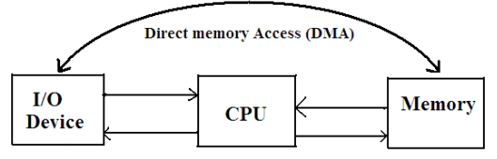
As an example , the data transfer between a floppy disk and a R/W memory in a computer system is based on DMA. To perform the DMA transfer in 8085 based systems two pins HOLD and HLDA (Hold Acknowledge) are used. An I/O device which wishes to transfer data using DMA scheme, sends the HOLD signal to the CPU.

Slide 4
On receiving the HOLD signal from an I/O device, the CPU sends a hold acknowledge signal (HLDA) to the I/O device to indicate that it has received the HOLD request and it will give-up the buses in the next machine cycle. The I/O device takes over the control of buses and directly transfer data to the memory or reads data from the memory.

Slide 5
How DMA Operations are Performed?
Following is the sequence of operations performed by a DMA −
Initially, when any device has to send data between the device and the memory, the device has to send DMA request (DRQ) to DMA controller.
The DMA controller sends Hold request (HRQ) to the CPU and waits for the CPU to assert the HLDA.
Then the microprocessor tri-states all the data bus, address bus, and control bus. The CPU leaves the control over bus and acknowledges the HOLD request through HLDA signal.
Now the CPU is in HOLD state and the DMA controller has to manage the operations over buses between the CPU, memory, and I/O devices.

Slide 6
Features of 8257
Here is a list of some of the prominent features of 8257 −
It has four channels which can be used over four I/O devices.
Each channel has 16-bit address and 14-bit counter.
Each channel can transfer data up to 64kb.
Each channel can be programmed independently.
Each channel can perform read transfer, write transfer and verify transfer operations.
It generates MARK signal to the peripheral device that 128 bytes have been transferred.
It requires a single phase clock.
Its frequency ranges from 250Hz to 3MHz.
It operates in 2 modes, i.e., Master mode and Slave mode.

Slide 7
DMA Controller - Intel 8237/8257 In Direct Memory Access technique, the data transfer takes place without the intervention of CPU, so there must be a controller circuit which is programmable and which can perform the data transfer effectively. For this purpose Intel introduced the controller chip 8257 which is known as DMA controller.
A DMA controller temporarily borrows the address bus, data bus and control bus from the microprocessor and transfers the data bytes directly from the port to memory devices. As the transfer is handled totally by hardware, it is much faster than software program instructions. A DMA controller can also transfer data from memory to a port.

Slide 8
Salient Features Intel 8257 is a programmable, 4-channel direct memory access controller i.e., four peripheral devices can request data transfer at any instant. The request priorities are decided internally. Each channel has two signals, DRQ (DMA Request) and (DMA acknowledge).
Each channel has two 16 bit registers. One for the memory address where the data transfer should being and the second for a 14-bit count. There are also two 8-bit registers one is the mode set register and the other is status register. It can operate both in slave and master mode. It is a totally TTL compatible chip

Slide 9
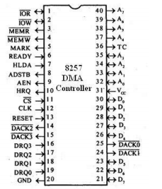
Pin Diagram: 8257 is a 40 pin IC package which requires a single +5V supply for its operation. The pin details are as follows. The pin diagram is shown in Fig below.

Slide 10
DRQ0−DRQ3 - These are the four-individual channel DMA request inputs, which are used by the peripheral devices for using DMA services. When the fixed priority mode is selected, then DRQ0 has the highest priority and DRQ3 has the lowest priority among them.
DACKo − DACK3 - These are the active-low DMA acknowledge lines, which updates the requesting peripheral about the status of their request by the CPU. These lines can also act as strobe lines for the requesting devices.

Slide 11
Do − D7 - These are bidirectional, data lines which are used to interface the system bus with the internal data bus of DMA controller. In the Slave mode, it carries command words to 8257 and status word from 8257. In the master mode, these lines are used to send higher byte of the generated address to the latch. This address is further latched using ADSTB signal.
IOR - It is an active-low bidirectional tri-state input line, which is used by the CPU to read internal registers of 8257 in the Slave mode. In the master mode, it is used to read data from the peripheral devices during a memory write cycle.

Slide 12
IOW - It is an active low bi-direction tri-state line, which is used to load the contents of the data bus to the 8-bit mode register or upper/lower byte of a 16-bit DMA address register or terminal count register. In the master mode, it is used to load the data to the peripheral devices during DMA memory read cycle.
CLK - It is a clock frequency signal which is required for the internal operation of 8257.
RESET - This signal is used to RESET the DMA controller by disabling all the DMA channels.

Slide 13
Ao - A3 - These are the four least significant address lines. In the slave mode, they act as an input, which selects one of the registers to be read or written. In the master mode, they are the four least significant memory address output lines generated by 8257.
CS - It is an active-low chip select line. In the Slave mode, it enables the read/write operations to/from 8257. In the master mode, it disables the read/write operations to/from 8257.
A4 - A7 - These are the higher nibble of the lower byte address generated by DMA in the master mode

Slide 14
READY - It is an active-high asynchronous input signal, which makes DMA ready by inserting wait states.
HRQ - This signal is used to receive the hold request signal from the output device. In the slave mode, it is connected with a DRQ input line 8257. In Master mode, it is connected with HOLD input of the CPU.
HLDA - It is the hold acknowledgement signal which indicates the DMA controller that the bus has been granted to the requesting peripheral by the CPU when it is set to 1.
MEMR - It is the low memory read signal, which is used to read the data from the addressed memory locations during DMA read cycles.

Slide 15
MEMW - It is the active-low three state signal which is used to write the data to the addressed memory location during DMA write operation.
ADST - This signal is used to convert the higher byte of the memory address generated by the DMA controller into the latches.
AEN - This signal is used to disable the address bus/data bus.
TC - It stands for „Terminal Count‟, which indicates the present DMA cycle to the present peripheral devices.

Slide 16
MARK - The mark will be activated after each 128 cycles or integral multiples of it from the beginning. It indicates the current DMA cycle is the 128th cycle since the previous MARK output to the selected peripheral device.
Vcc - It is the power signal which is required for the operation of the circuit.

Slide 17
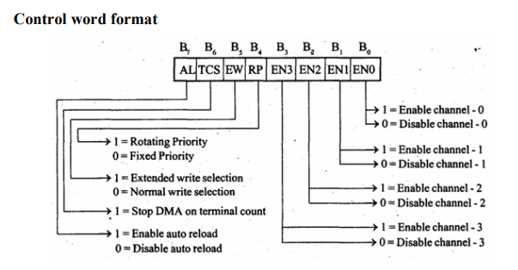

Slide 18
Block Diagram:
The functional block diagram is shown below.It consists of
Data bus buffer
Read/Write logic
DMA channels
Control logic
Mode set Register
Priority resolver

Slide 19
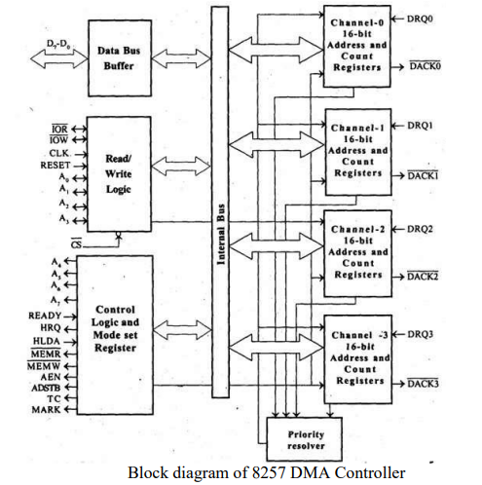

Slide 20
Data Bus Buffer:
Three state bidirectional, 8 bit buffer interfaces the 8257 to the system data bus. When the 8257 is being programmed by the CPU, eight bits of data for DMA address register, a terminal count register or the mode set register are received on the data bus. When the CPU reads the DMA address register, a terminal count register or status register, the data is sent to the CPU over the data bus. When 8257 is operating as Master, during a DMA cycle, it gains control over the system buses.

Slide 21
Read/Write Logic:
In the slave mode, when the CPU reads data from or writes data to the 8257, the read/write logic accepts the I/OR (or) I/OW signals and decodes the least significant 4 address bits (A0 - A3). During DMA cycles, when 8257 is the master, the read/write logic generates the I/O read and memory write or I/O write and memory read signals which controls the data link with the peripheral that has been granted DMA cycle. The different signals are
(I/O Read):
It is active low bidirectional three-state line. In the slave mode, it is an input, which allows the 8-bit status register or upper/lower byte of a 16 bit DMA address register of terminal count register to be read. In the master mode, is a control output, which is used to access data from a peripheral during the DMA write cycle.

Slide 22
(I/O Write): It is an active low bi-directional tri-state line. In slave mode, it is an input, which allows microprocessor to write. In the master mode, is a control output, which allows data to be output in the peripheral during DMA read cycle.
CLK (Clock Input): This is the clock output of the microprocessor.
RESET: It is an asynchronous input from the microprocessor which disables all DMA channels by clearing the mode register and tri-states all control lines.

Slide 23
A0 - A3 (Address Lines): These least significant four address lines are bidirectional. In the slave mode they are inputs, which select one of the registers to be read or programmed. In the master mode, they are outputs, which constitute the most significant 4 bits of the 16 bit memory address generated by the 8257.
CS(Chip Select) It is an active low input which enables the I/O read or I/O write input when the 8257 is being read or programmed in the slave mode. In the master mode, is automatically disabled to prevent the chip from selecting while performing the DMA function.
Control Logic Block: This block controls the sequence operations during all DMA cycles by generating the appropriate control signals and 16 bit address that specifies the memory relations to be accessed

Slide 24
A4 - A7 (Address Lines): These four address lines are tri-stated outputs which contains 4 to 7 of the 16 bit memory address generated by the 8257 during all DMA cycles.
READY: This is an asynchronous input used to insert wait states during DMA read or write machine cycles. Wait states are included between S3 and S4 states of the duty transfer.
HRQ (Hold Request): This output line requests the control of the system bus. This is connected to the HOLD input of 8086.

Slide 25
DMA Channels: The 8257 has four separate DMA channels each channel with two 16 bit registers (1) a DMA address register (2) Counter register. Both these registers must be initialized before a channel is enabled. The DMA address register is loaded with the address of the first memory location to be accessed. The value loaded into the low order 14 bits of the terminal count register specifies the number of DMA cycles minus one before the terminal count output is activated.
DRQ0 - DRQ3 (DMA Request): These are active low signals one for each of the four DMA channels. The output acts as a chip select for the peripheral device requesting service. The DACK line becomes 0 and then 1 for each byte of DMA data transfer.

Slide 26
Mode Set Register: This register is used to set the mode of operation of 8257. It is normally programmed by the CPU after the DMA address register and terminal count registers are initialized. This register is cleared by RESET input, by disabling all options. The mode set register is shown in Fig. By setting the 4th bit we can opt for rotating priority.
Normally DRQ0 has highest priority and DRQ3 has lowest priority. But in the rotating priority mode the priority of the channels has a circular sequence and after each DMA cycle, the priority of each channel changes. If the rotating priority bit is reset, (is a zero) each DMA channel has a fixed priority in the fixed priority mode. i.e., channel 0 has highest priority and channel-3 has lowest priority.

Slide 27
DMA Working In 8086 microprocessor two lines dedicated for DMA operation. They are HOLD and HLDA. If any device is in need of DMA service it activates a DRQ line. Now the 8257 in turn sends out HOLD request (HRQ) to microprocessor on HOLD line.
The microprocessor then completes the current machine cycle and then goes to HOLD state, where the address bus, data bus and the related control bus signals are tri-stated. Now the HLDA signal is activated.

Slide 28
The DMA controller which is a slave to the microprocessor so far will now become the master. The DMA controller resolves the priorities of the requesting I/O devices and accordingly sends a signal to the suitable I/O device.
The 8257, after sending out a signal to the requesting I/O device, generates and signals if it is a DMA read operation. 8257 generates and signals for DMA write operation. Then a byte of data is transferred between I/O device and memory directly in 4 clock cycles. This is known as a DMA machine cycle.

Slide 29
The 8237 works in two modes i.e., master and slave modes.
In slave mode, the 8237 functions as an input/output device. In this mode the system buses arc controlled by microprocessor and hence the microprocessor is connected to the system bus.
In master mode 8237 becomes the bus master and hence the microprocessor is isolated from the system bus. This isolation is done by AEN signal.
In minimum configuration, 8237 DMA controller is used to transfer the data. The peripheral chips are interface as normal 10 ports. Figure shows the interfacing of DMA controller with 8086.
In minimum mode the HOLD and HLDA signals are used to bus arbitration and in maximum mode configuration RQ_0/GT_0; and RQ_1/GT_1.
The 8237 outputs only 16-bit memory address but not the complete 20-bit address of 8086. To store the remaining four address hits A_16—A_19 a separate page latch is required.
The 8237 is not compatible with 8086 in its maximum mode configuration. This is because RQ/GT is not compatible with HRQ and HLDA of 8237.
So if 8086 is to be interfaced with DMA controller, then 8089 10 processor is required.
The 8089 interfaces to the 8086's local multiplexed buses. It shares the bus buffers and system controller of the host system. It is compatible with the RQ/GT signals of 8086 and outputs the complete 20-bit address.

Slide 30
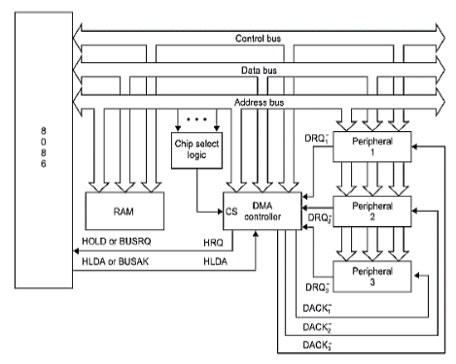

Slide 31
Different data transfer modes of 8237 DMA controller:
The 8237 is in the idle cycle if there is no pending request or the 8237 is waiting for a request from one of the DMA channels. Once a channel requests a DMA service, the 8237 sends the HOLD request to the CPU using its HRQ pin. If the CPU acknowledges the hold request on HLDA, the 8237 enters an active cycle. In the active cycle, the actual data transfer takes place in one of the following transfer modes as is programmed.
Single Transfer Mode: In this mode, the device transfers only one byte per request. The word count is decremented and the address is decremented or incremented (depending on programming) after each such transfer. The Terminal Count (TC) state is reached when the count becomes zero. For each transfer the DREQ must be active until the DACK is activated, in order to get recognized. After TC the bus will be relinquished for the CPU. For a new DREQ to 8237 it will again activate the HRQ signal to the CPU and the HLDA signal from the CPU will push the 8237 again into the single transfer mode. This mode is also called as 'cycle stealing'.
Block Transfer Mode: In this mode, the 8237 is activated by DREQ to continue the transfer until a TC is reached, i.e. a block of data is transferred. The transfer cycle may be terminated due to EOP (either internal or external) which forces Terminal Count (TC). The DREO needs to be activated only till the DACK signal is activated by the DMA controller. Auto-initialization may be programmed in this mode.

Slide 32
Demand Transfer Mode: In this mode, the device continues transfers until a TC is reached or an external EOP is detected or the DREQ signal goes inactive. Thus a transfer may exhaust the capacity of data transfer of an I/O device. After the I/O device is able to catch up the service may be re-established activating the DREQ signal again. Only the EOP generated by TC or external EOP can cause the auto-initialization, and only if it is programmed for.
Cascade Mode: In this mode, more than one 8237 can be connected together to provide more than four DMA channels. The HRQ and HLDA signals from additional 8237s are connected with DREQ and DACK pins of a channel of the host 8237 respectively. The priorities of the DMA requests may be preserved at each level. The first device is only used for prioritizing the additional devices (slave 8237s), and it does not generate any address or control signal of its own. The host 8237 responds to DREQ generated by slaves and generates the DACK and the HRQ signals to coordinate all the slaves. All other outputs of the host 8237 are disabled.
Memory to memory Transfer:
To perform the transfer of a block of data from one set of memory address to another one, this transfer mode is used.
Programming the corresponding mode bit in the command word, sets the channel 0 and I to operate as source and destination channels, respectively. The transfer is initialized by setting the DREQ0 using software commands.
The 8237 sends HRQ (Hold Request) signal to the CPU as usual and when the HLDA signal is activated by the CPU. the device starts operating in block transfer mode to read the data from memory.

Slide 33
Memory to memory Transfer:
The channel 0 current address register acts as a source pointer. The byte read from the memory is stored in an internal temporary register of 8237. The channel 1 current address register acts as a destination pointer to write the data from the temporary register to the destination memory location.
The pointers are automatically incremented or decremented, depending upon the programming. The channel 1 word count register is used as a counter and is decremented after each transfer. When it reaches zero, a TC is generated, causing EOP to terminate the service.
The 8237 also responds to external EOP signals to terminate the service. This feature may be used to scan a block of data for a byte. When a match is found the process may be terminated using the external EOP. Under all these transfer modes, the 8237 carries out three basic transfers namely, write transfer, read transfer and verify transfer.
In write transfer, the 8237 reads from an I/O device and writes to memory under the control of IOR and MEMW signals. In read transfer, the 8237 reads from memory and writes to an I/O device by activating the MEMR and IOW signals. In verify transfers, the 8237 works in the same way as the read or write transfer but does not generate any control signal.

